Slide 1
Onderwerp presentatie
Crafting integrated IT solutions that make your business thrive.
Naam presentator
Functie
naam@faros.be
+32 (0)4 95 42 59 45
Java projects & consultancy
Web applications
Reactive Programming
Naam presentator
Functie
naam@faros.be
+32 (0)4 95 42 59 45
www.faros.be | hello@faros.be

Slide 2

Agenda
Subject nummer 1
Subject nummer 2
Subject nummer 3
Subject nummer 4
5’
15’
10’
30’

Slide 4
A culture of passion and innovation
ARE YOU A DEVELOPER WITH A PASSION FOR JAVA? LET'S HAVE A COFFEE!

Slide 5
Skills and services
Thinkers + Makers = Value Creators
SOFTWARE DEVELOPMENT & PROJECTS
Providing quality, limiting risks & maximizing customer value for your IT project, that's our passion.
IT CONSULTANCY
The Java ecosystem is our preferred development habitat. Are you looking for temporary manpower and expertise in Java? Look no further, let's team up!
AUDITS & TRAINING
Faros has multiple certified Spring trainers, and is the only company in Belgium to do so! Besides Spring trainings, we can also audit your existing Spring projects.

Slide 6
Timeline
Vul het proces aan
START
Providing quality, limiting risks & maximizing customer value for your IT project, that's our passion.

Slide 7

Streepje code
Designen van reactieve API’s
Info over de code

Slide 8
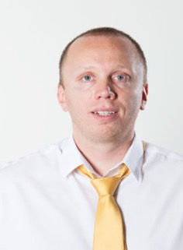
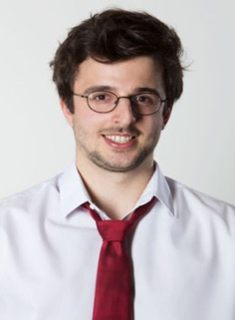
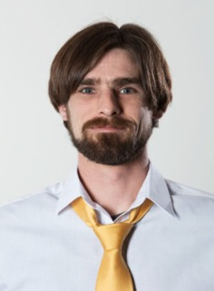
Our Team
Thinkers and makers
Jeroen Sterken
Managing Partner

Slide 9
Software development
We limit the risks & maximize customer value for your IT project
Customer applications
Application-integration and middleware
Internet of Things
User eXperience and Innovation
Responsive frontend design
Testing & User Adoption
We strongly believe in joint partnerships and an agile approach, providing you frequent feedback loops.

Slide 10

Tussenslide
Hier kan een subtitel komen

Slide 11
Klanten
WE THINK, MAKE AND CREATE VALUE
Sven C.
Dimi
Luc

Slide 12
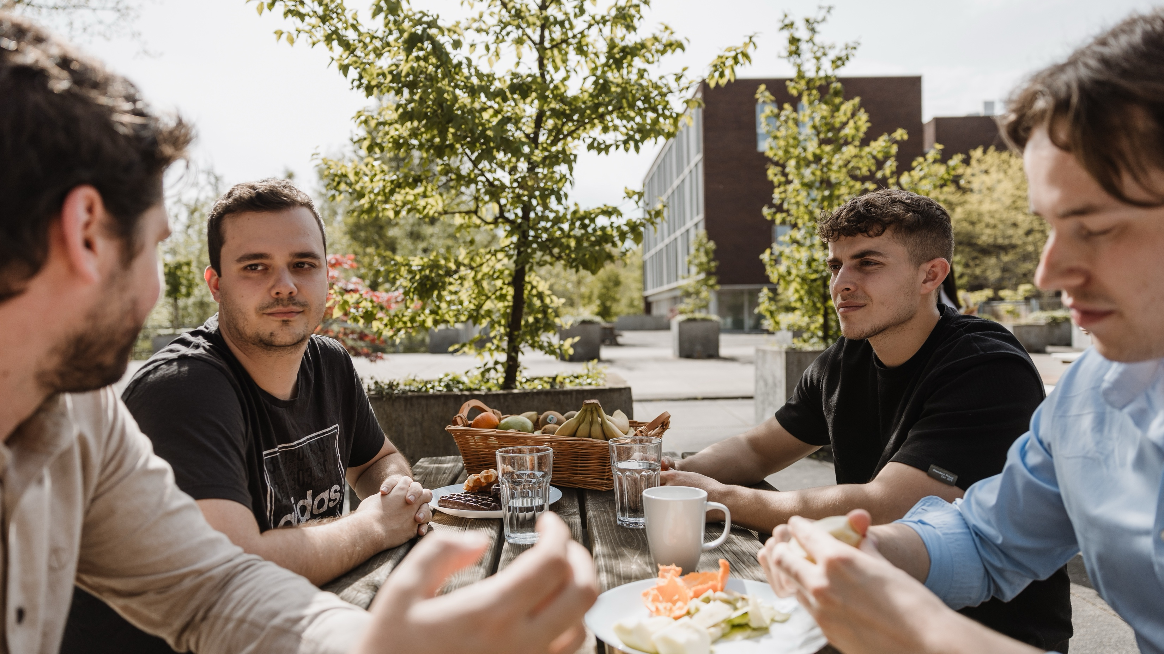

Slide 13

“Quote here Thinkers + Makers = Value Creators”
MAC: Afbeelding inslepen + op 70% transparantie zetten
WINDOWS: Afbeelding inslepen + vlak kopiëren en plakken (uit slide met elementen) en op 30% transparantie zetten
- Some smart guy

Slide 14


Slide 15

Duo afbeelding/tekst

Slide 16

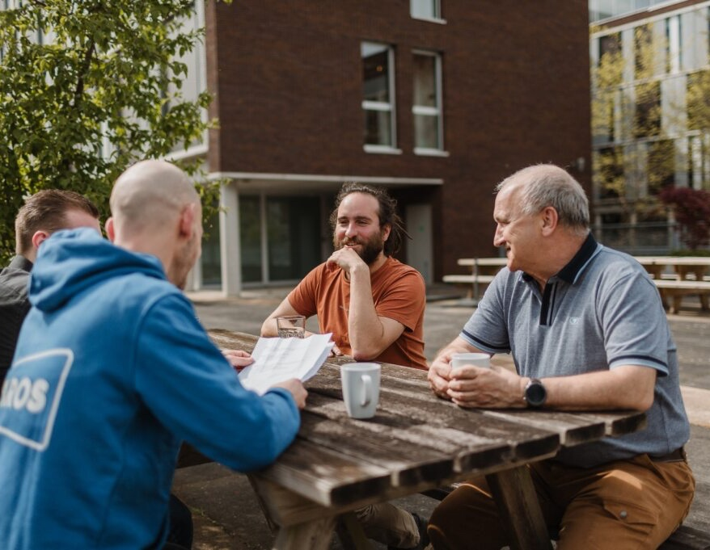
Sfeerbeelden
En dit is ons team…

Slide 17
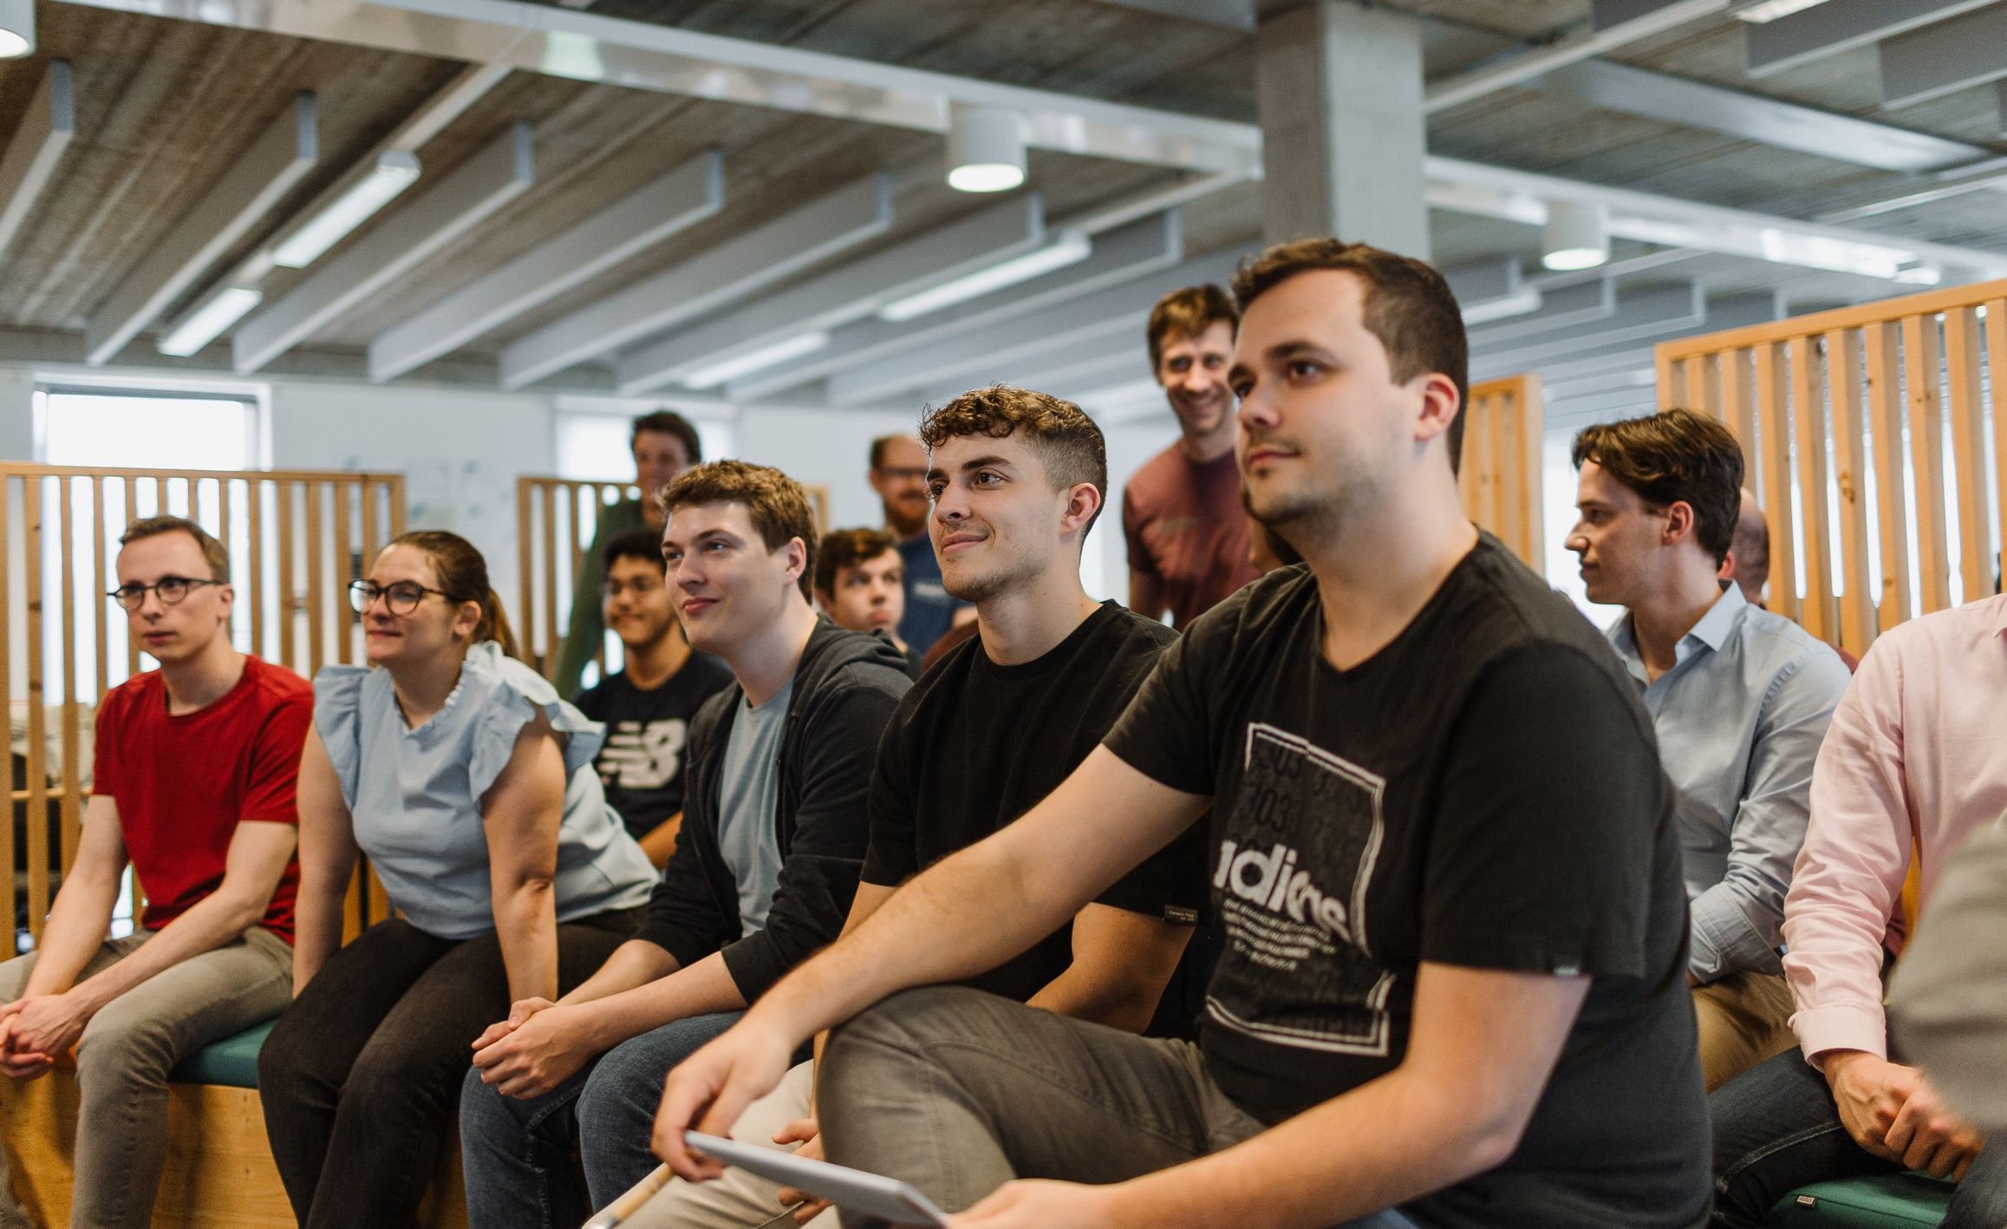
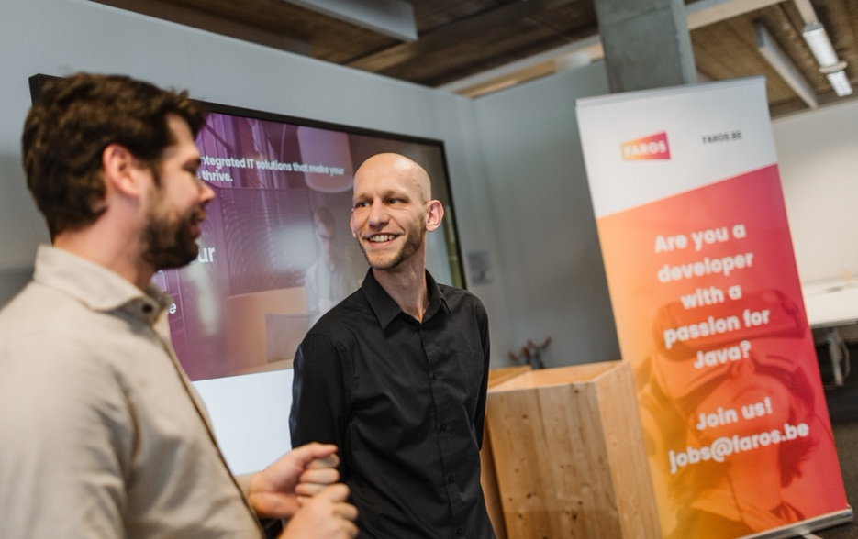


Slide 18

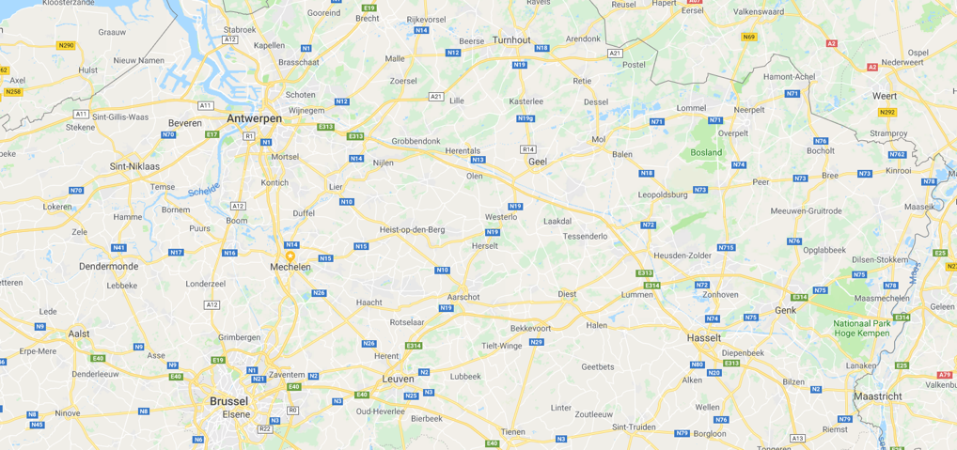
Where?
Or where not?

Slide 19
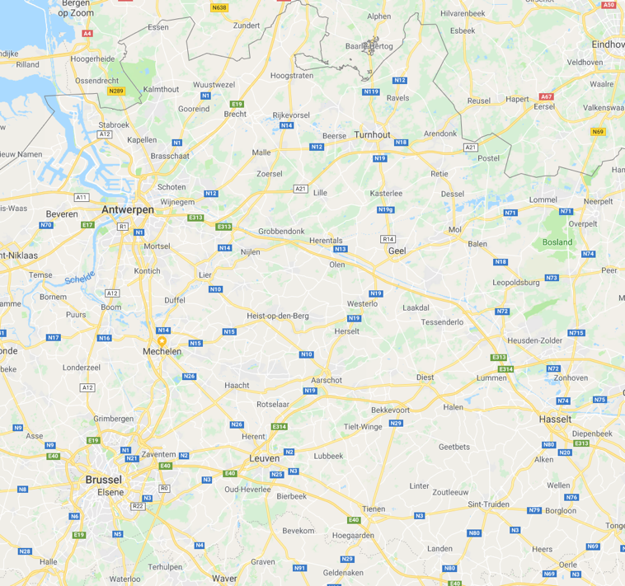
Contact
Gaston Geenslaan 11 B4
3000 Leuven
hello@faros.be
+32(0)16 240 840
Naam presentator
presentator@faros.be
+32(0)4########
@FarosBelgium
farosbe

Slide 20
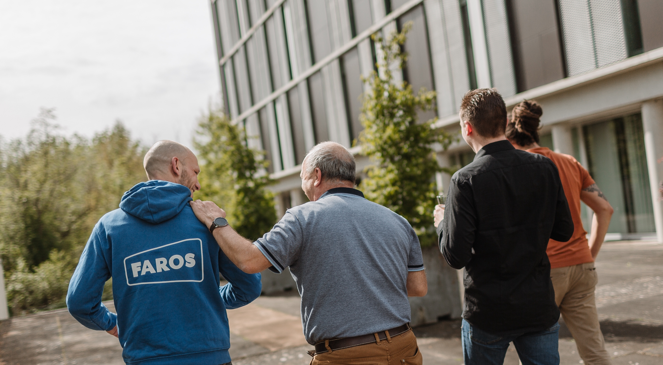

Slide 21



Kopiëren & plakken
Elementen en Opmaak
Tekst gradient
Tekst
Tekst
Tekst
Tekst
Web applications

